Slide 1
ANML Presentation
Start with ANML as a follow up of OML and MAML
- Opmitize what you want directly instead of hand picked decisions

Slide 2
I like this paper
Notes:
To me it was a good opportunity to disentangle why I intuitively like this papers.
What are in details the interesting components.
But also to not discard the issues I don't like, but rather try to find solutions

Slide 3
Meta-Learning

Slide 4
Overcompletness
ANML has 7mil parameter
How many to classify all omniglot ? (image here)
Sparse representation has its own power, but also has its cost : you need to be over complete
Yet we know its not enough
Notes:
First, with 7 million parameters, the network is over- complete.
But we've known for decades that doesn't change catastrophic forgetting, it happens anyway to almost the same degree.
Do with their success at 600 classes ANML is not testing the limits of their network

Slide 5
Neuromodulation
Similar to Partial Softmax mentioned Monday, but controlled by a NN

Slide 6
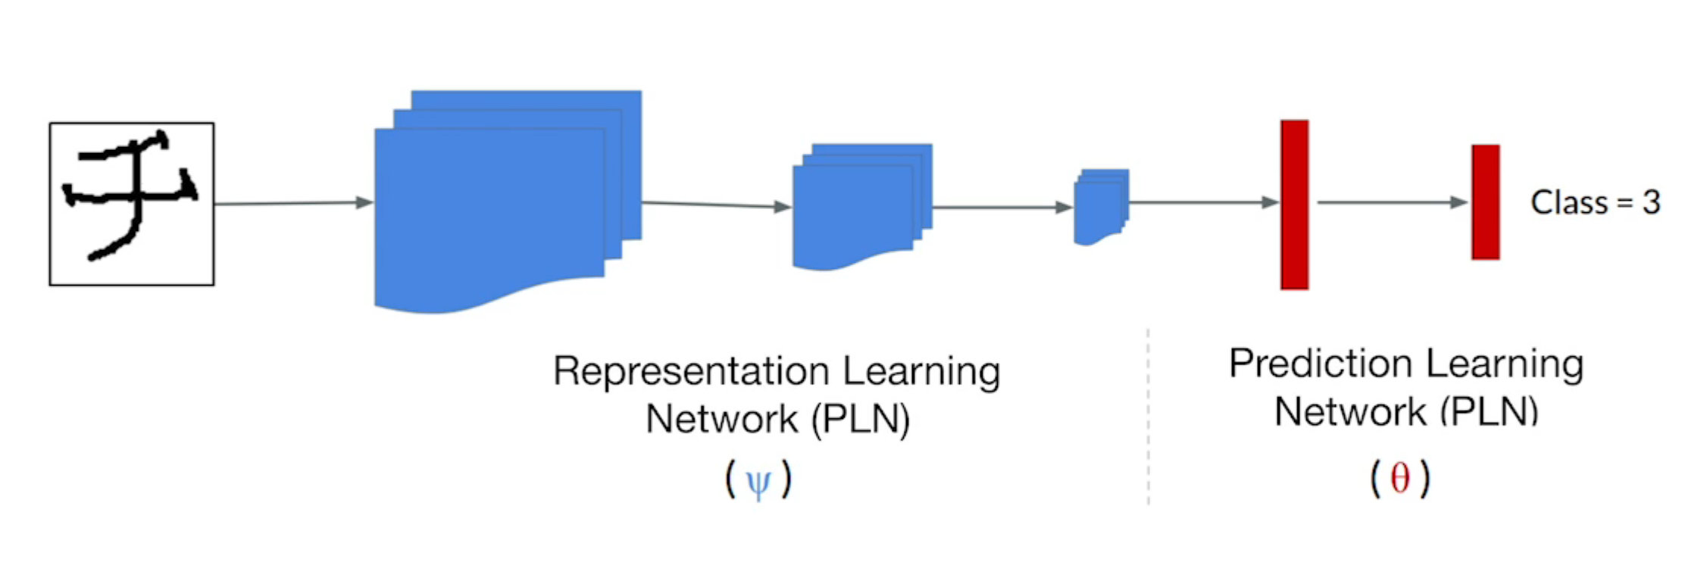
OML
Javed & White 2019
Notes:
This story starts with OML where the authors meta-trained the convolution part of a network and was frozen at meta-testing time where only the prediction network learns

Slide 7
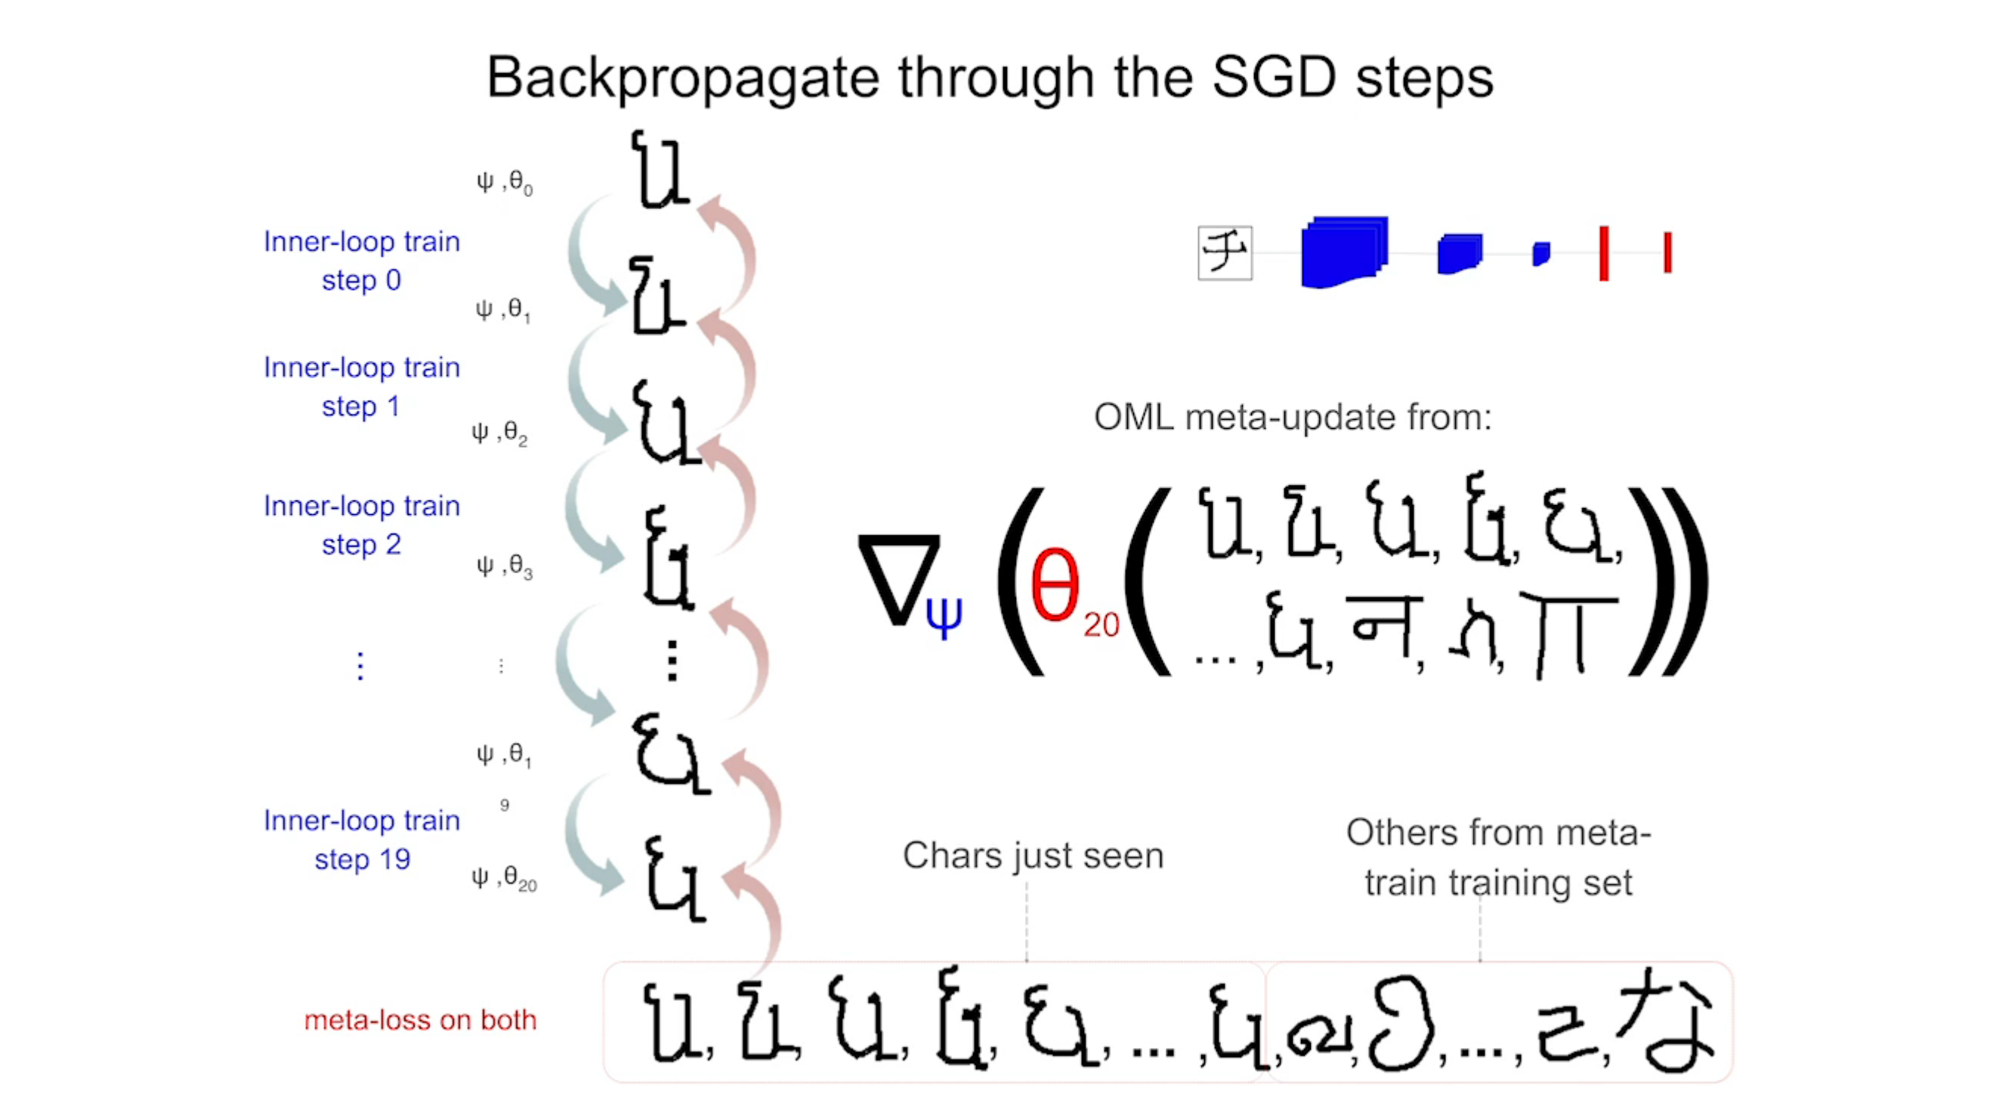

Slide 8
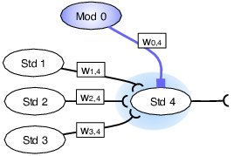

Traditional neuromodulation
Soltoggio et al. (2008)
Figure 2: Ovals represent standard and modulatory neurons labelled with Std and Mod. A modulatory neuron transmits a modulatory signal – represented as a coloured shade – that diffuses around the synapses of the target neuron. Modulation affects the update of the afferent weights $w_{1,4}$ , $w_{2,4}$ and $w_{3,4}$.
Notes:
The authors of ANML wanted to include a certain type neurons in the brain to takle continual learning
Neuromodulation neurons change the learning rate of other neurons and thus enables task-specific learning

Slide 9
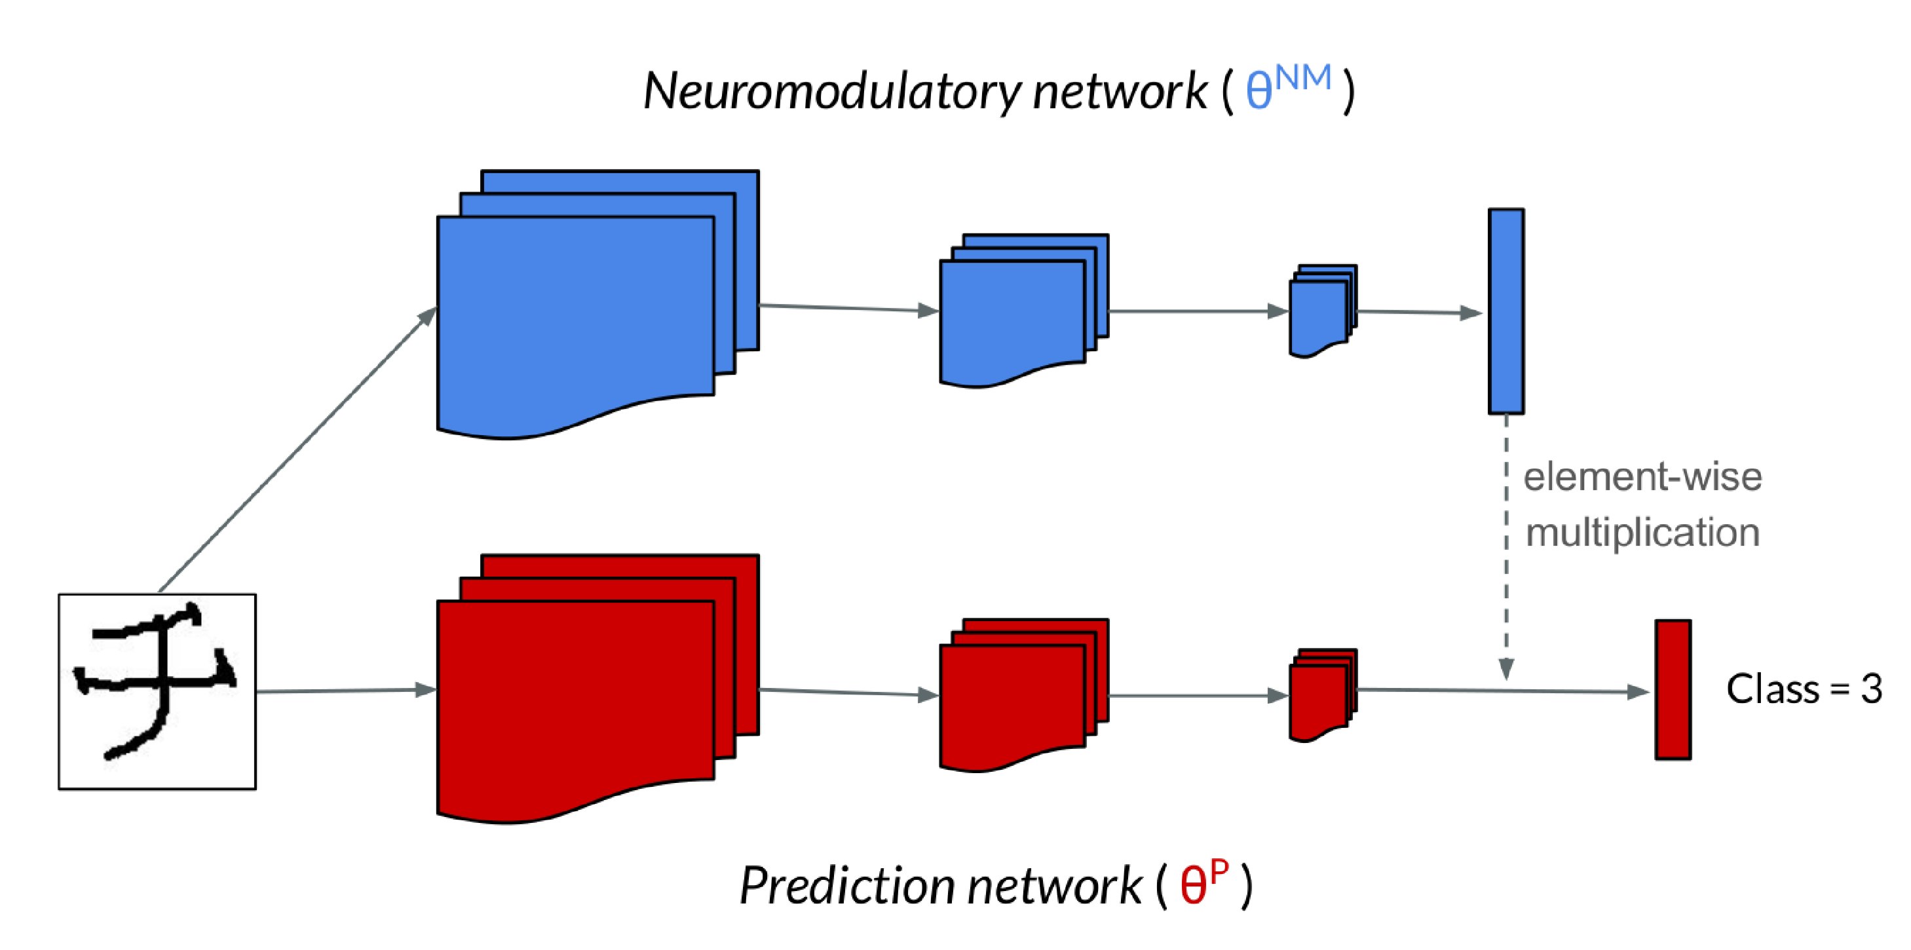
ANML

Slide 10

$$1×ν$$
Notes:
You can think of them as the gates of a spill-way as it controls the outflow of the network.
Just like a spillway, this gating is not discrete but continuous (between 0 and 1)
But more importantly, it controls the gradient coming back, and therefore controls which parts of the network gets updated.
This gating is linear, but Future experiments could look into the potential of gating inside the network before non-linear activations
If anyway is looking for projects idea.
(Although I’m guessing this is what the authors are looking into now)
It would be nice to also be able to include the task information at the entry of the neural network…
Ideally in the form of a context vector, one that would increase in length with the number of distinctions
but I found this be problematic for CL setup

Slide 12
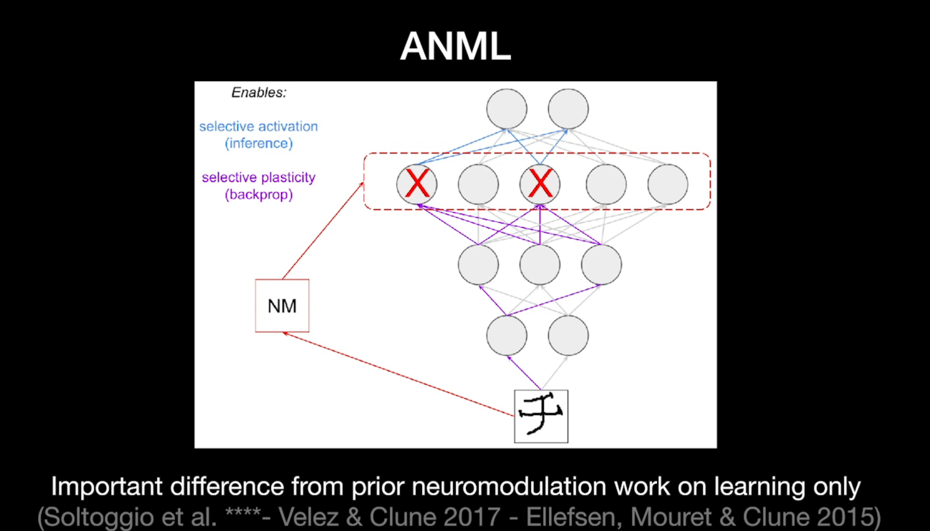

Slide 13
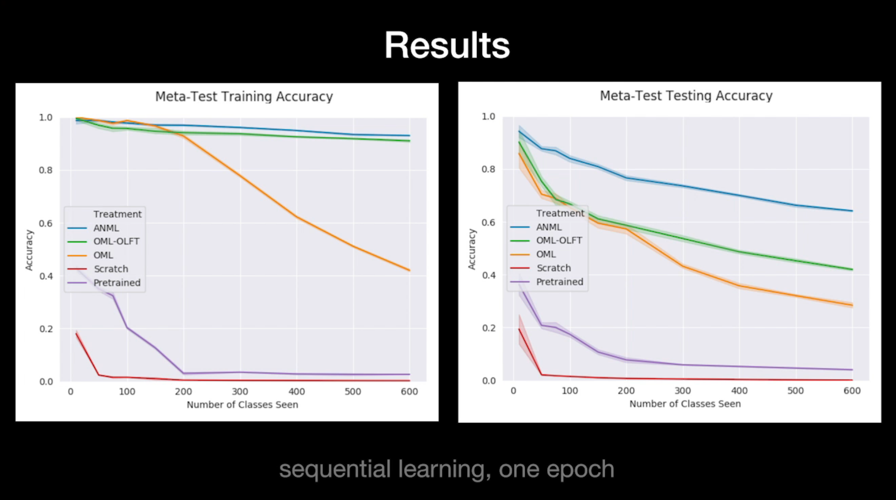

Slide 14
task is class

Slide 15
Meta-Loss Oracle

Slide 16
Number of Classes

Slide 17
Randomized list

Slide 18
We ran considering all these corrections
Summary
Don’t intend to make a ablation since this is the setup that I consider valid

Slide 19
Marie’s writing
Unknown at test time

Slide 20
Hard Task boundaries

Slide 21
Soft Task boundaries

Slide 22
Cellular Division in ANML
Distinction Network

Slide 23
Ideally plug context before the network

Slide 24
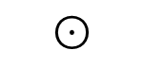

$$⊙$$
$$S$$
Notes:
-Long output vector is a extreme classification problem
- The authors train their network on output of size 1000 to be over their needs
But this is not dealing with an unknown number of classes
Experimental setup is of fixed output length, meaning we know the number of classes/tasks ahead of time
-Dynamic Neuromodulation Meta-Learning as a project
- No longer compatible in the Meta-Testing phase
Reveals that network bottleneck is actually a source of catastrophic forgetting

Slide 26
Why these Splits

Slide 27

GLOBAL VS LOCAL ACCURACY

Slide 28
GLOBAL VS LOCAL ACCURACY
Notes:
You did something right, but for the wrong reasons !

Slide 29
Context detection is the most important task
Notes:
Over time you will see that identifying the context becomes the hardest and most vital task poker or car on the road will have very different solutions depending on thecontext
Difference could be Suttle, correct output vastly different
My distinction network is simplest I could think of to test this setting. But this could be the most sofisticated part of a network. Let me explain

Slide 30
Sliding Gate theory

Slide 31
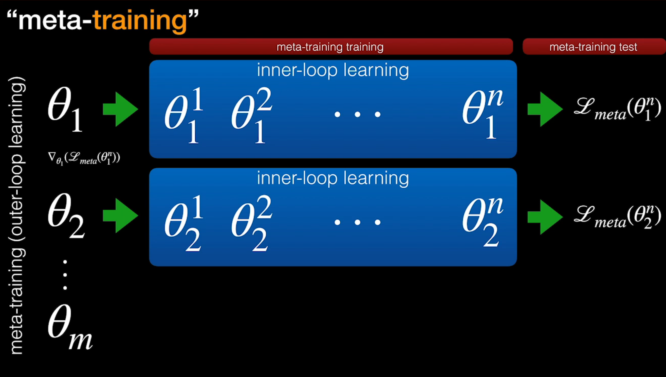
Meta-Training
Meta-Testing
Notes:
Just to clear out the confusing names of Meta-Learning
All you have to know that there are 2 levels of Training & Testing
The Meta-Testing would be a standard ML setup you would normally run. This is where the results counts
And Meta-Training is where you pre-train your model
Now that this is said, we’ll still be confused. It’s ok

Slide 32
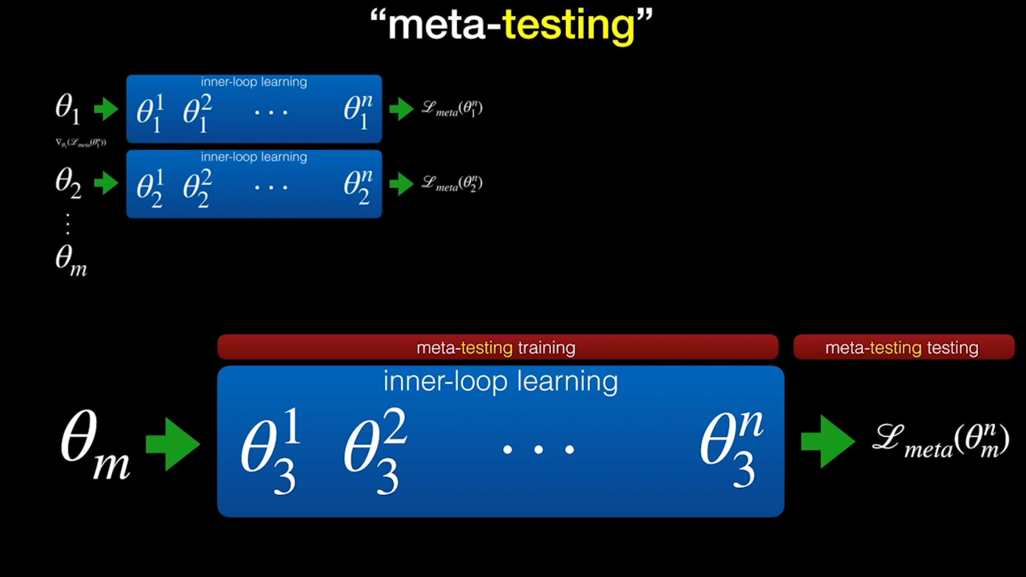

Slide 33
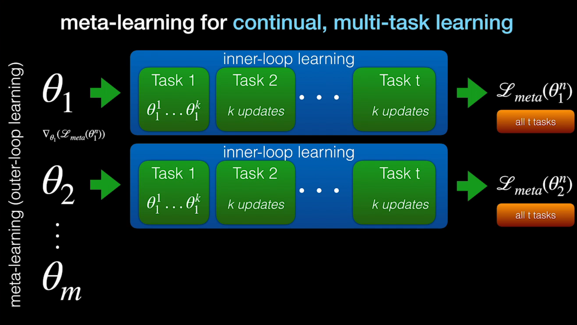

Slide 34

Structured SVM loss if Meta-Learn new class decisions

